Slide 1
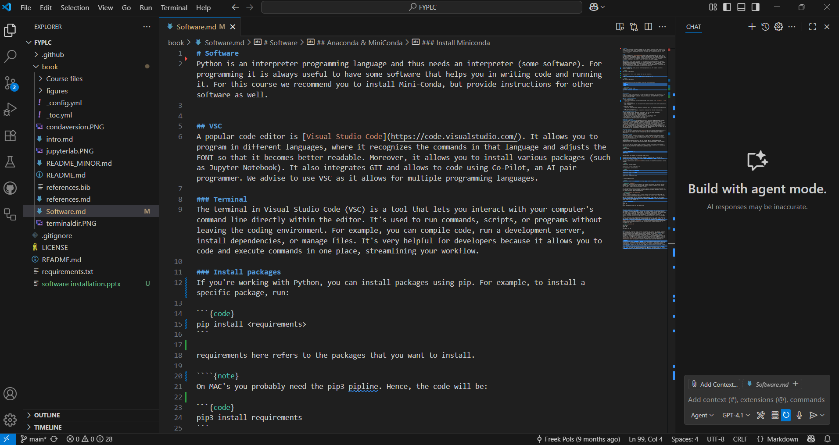
Software Installation
Freek Pols
c.f.j.pols@tudelft.nl

Slide 2
Start
Entire description can be found at https://contemporary-physicslab.github.io/FYPLC in chapter 2.

Slide 3
Software
VSC: Code editor
Python: Programming Language
GitHub: Version control system

Slide 4
VSC
Step 1:
Go to: https://code.visualstudio.com/download and download & install the correct version
Step 2:
Open VSC
Step 3:
Install the recommended extensions (see https://tinyurl.com/vscextensions)

Slide 5
Install python
Install Python (3.13) via the Microsoft Store or, for MAC, through https://www.python.org/downloads/macos/
If installed via other means, check if the folder containing the .exe is in the PATH system variable.
pip (package manager) should also be installed and added to your path.

Slide 6
Python test
Open VSC
Press ctrl + shift + p and choose Python: select interpreter
Choose Python 3.13.X (base)
Now Python is ready for you in the terminal. Check this by typing in the terminal:
python
print(2+3)
If done correctly, the answer (5) will be displayed in the terminal

Slide 7
Jupyter Notebooks
Create a new notebook (a .ipynb file) in VSC, or download one, and verify that it is working.

Slide 8
GitHub
Go to Github.com and make an account.

Slide 9
Git
Windows
In VSC, press the blue “Git for Windows” button
Download and run the latest version
MacOS
Check whether git is installed by typing in the terminal `git --version`
If Git isn’t there, you are prompted to install the Command Line Tools, or install Git directly from git-scm.com or via Homebrew with `brew install git`.

